Slide 1
DSBA 6160
Project: Big Bang Theory TV Series IMDB rating
Data Team 1
Team Members: Abey Dessie, Nizar Mamouni, Noah Hansil, Sina Saba, Sreelekha Mittinti

Slide 2
Use Case
The company is an advertising placement agency.
Providing large and small companies with appropriate advertising mediums is the agency's main function.
A customer will analyze the amount of viewers on the original airdate, the imdb rating for a given episode, as well as the impact of writers/directors.
It is the system administrator's responsibility to aggregate this information in the database and design stored procedures to display it according to the individual's needs.

Slide 3
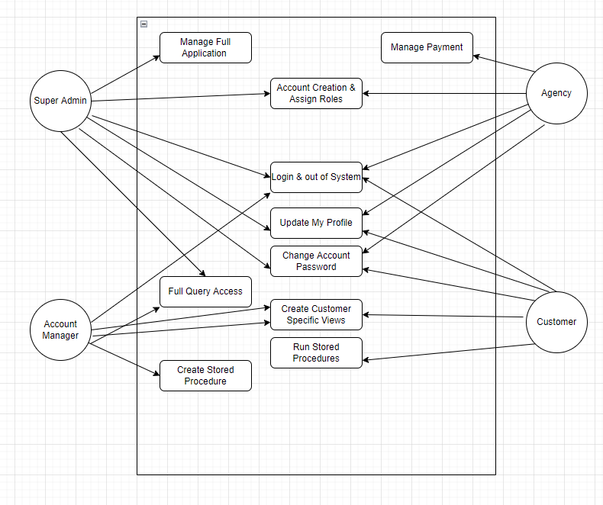
Use Case Diagram

Slide 4
Business Rules
Three Business Rules:
If the IMDB rating is higher than 7.5, it will be classified as high.
If the IMDB rating is lower than 7.5, it will be classified as low.
The directors are classified by their gender.

Slide 5
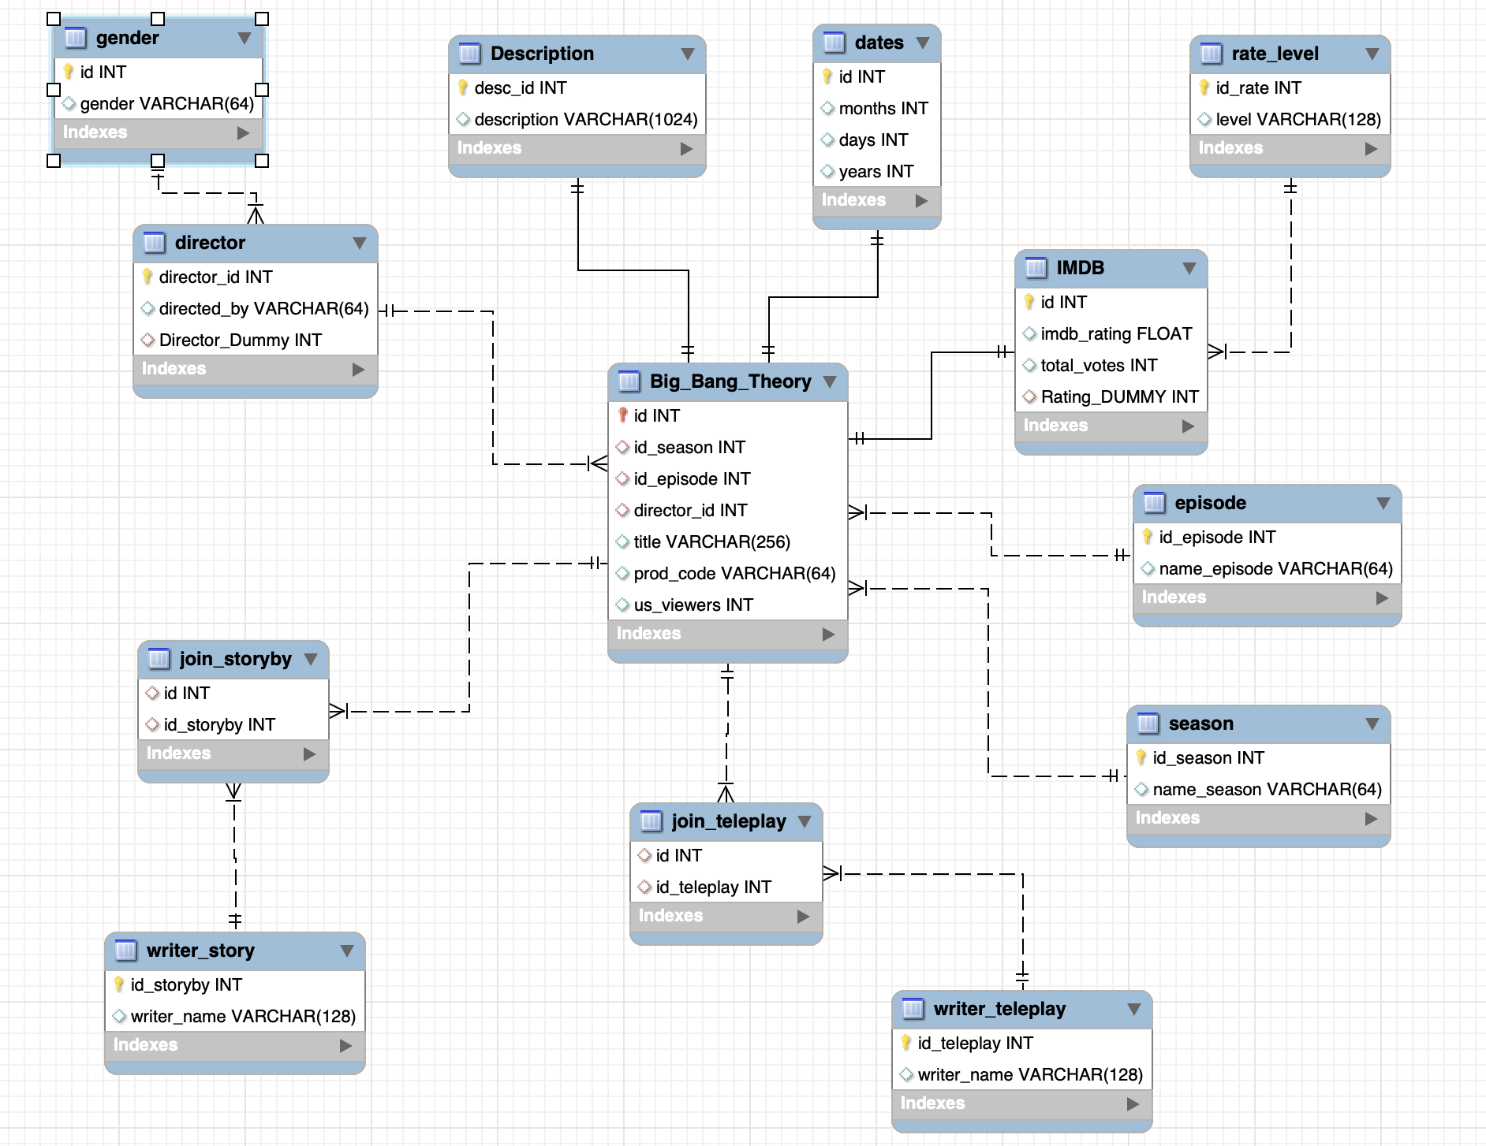
Entity-Relationship Diagram

Slide 6
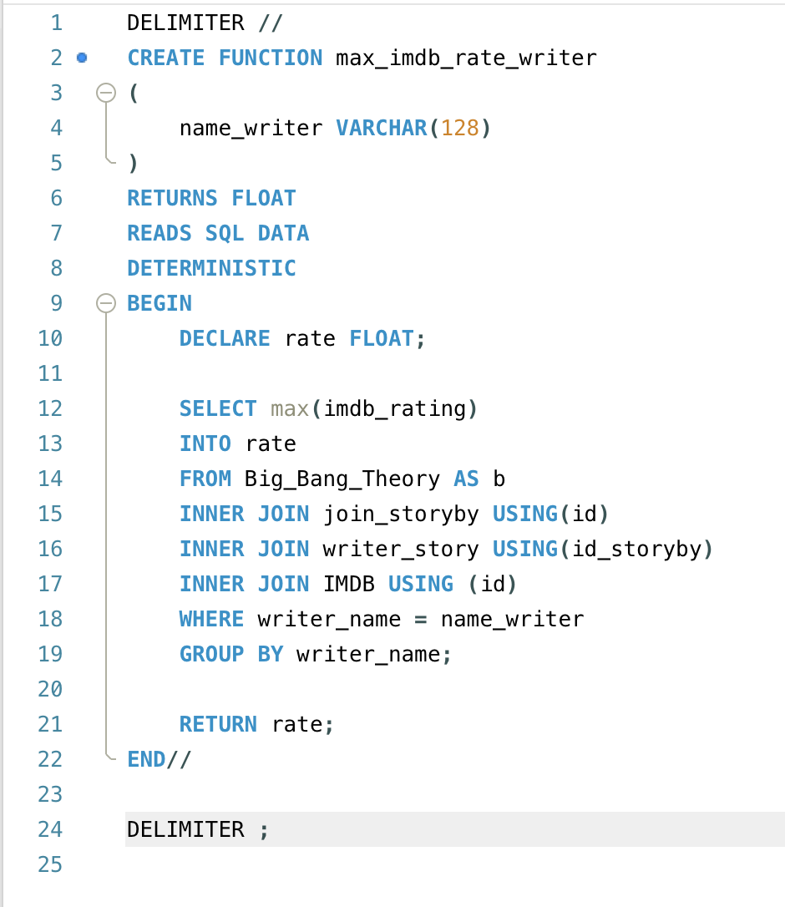
Function
The function created is called “max_imdb_rate_writer”. The function takes in the input of a string, this string will be of a writer’s name. The function outputs a float that is the highest IMDB rating of all episodes that writer is a part of.

Slide 7
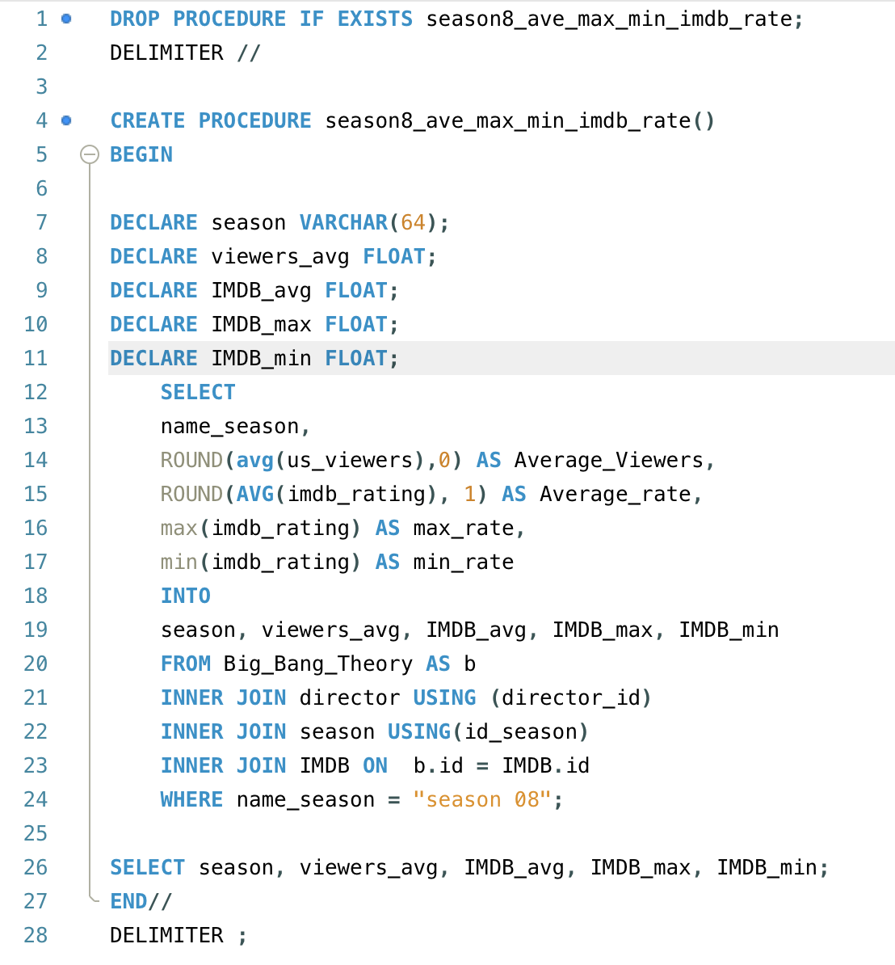
Procedures
The procedure created is called “season8_avg_max_min_imdb_rate”. This procedure returns an aggregate result for season 8 of the show Big Bang Theory. The procedure returns the average number of views, average IMDB rating, maximum rating, and minimum rating all for season 8.

Slide 8
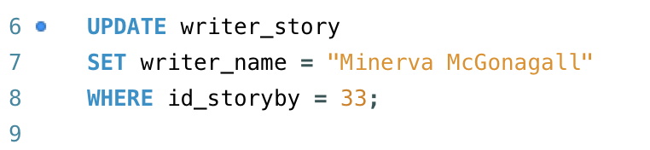
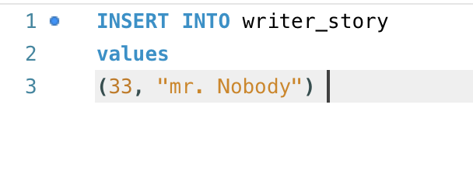
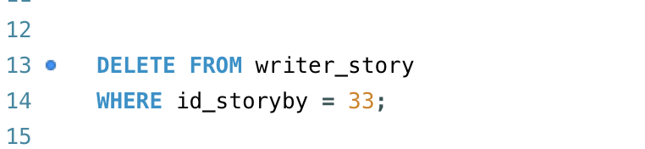
Complex Queries
Update data:
Insert data:
Delete data:

Slide 9
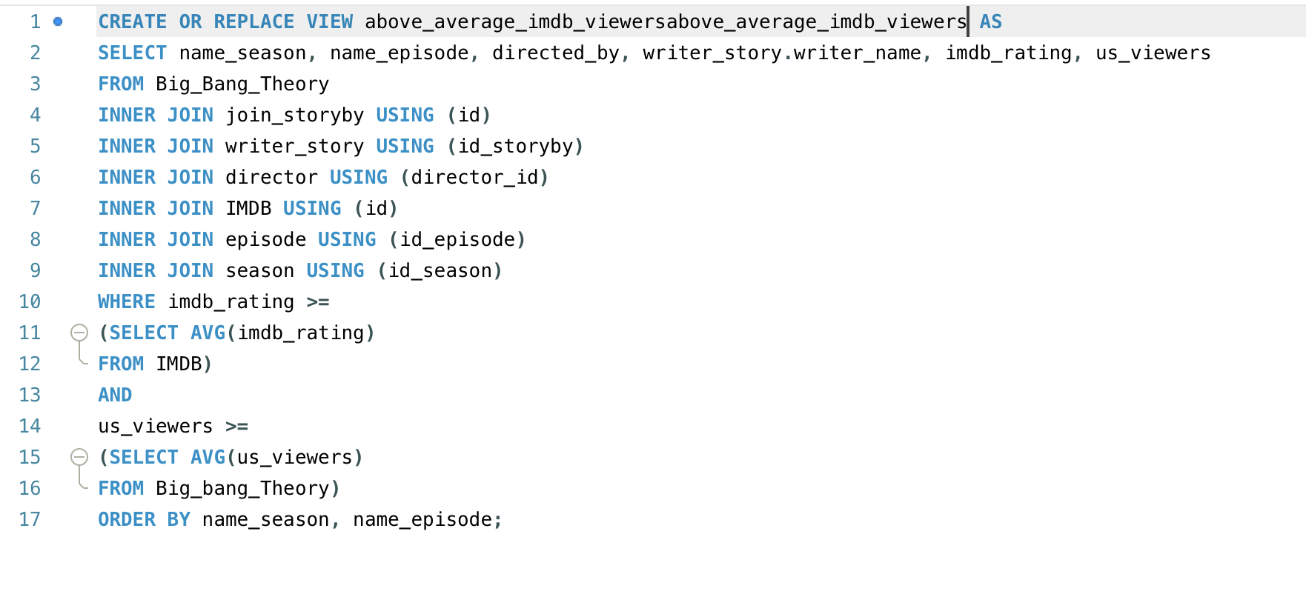
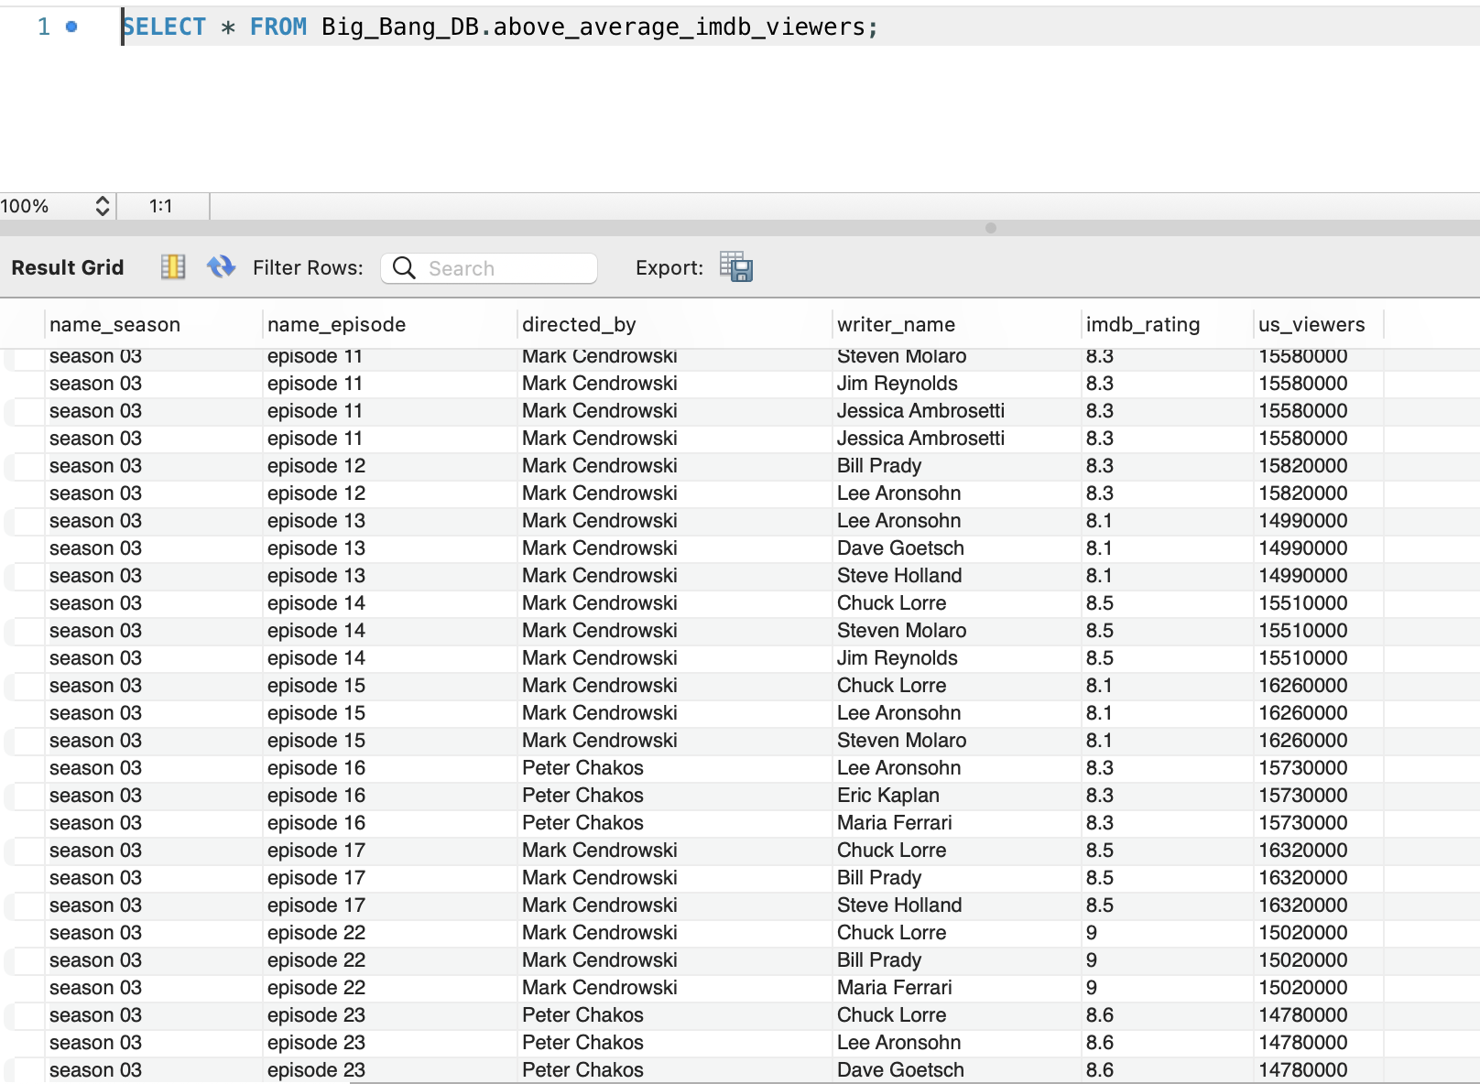
Views 1
Shows with IMDB rate & viewership above average

Slide 10
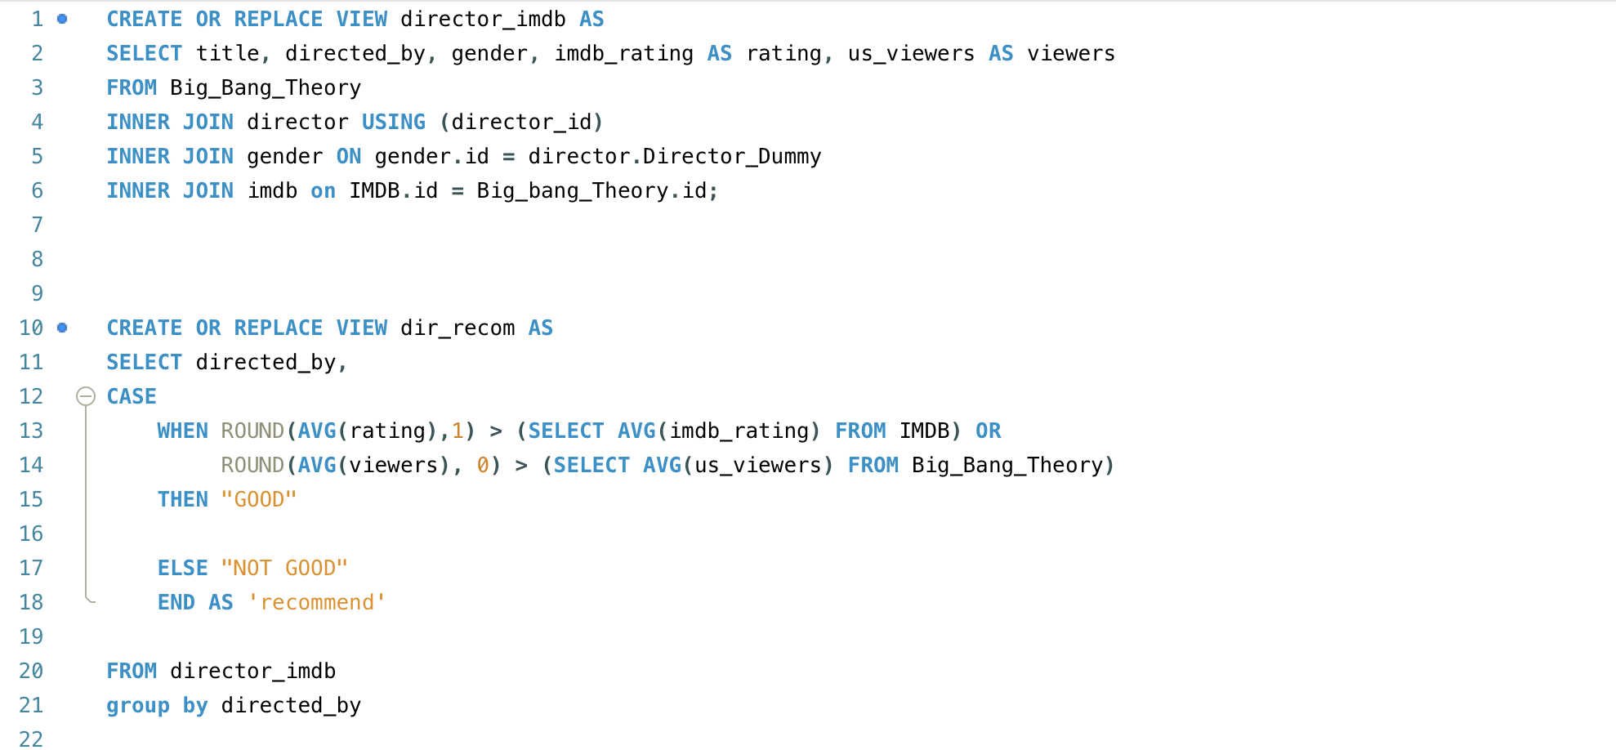
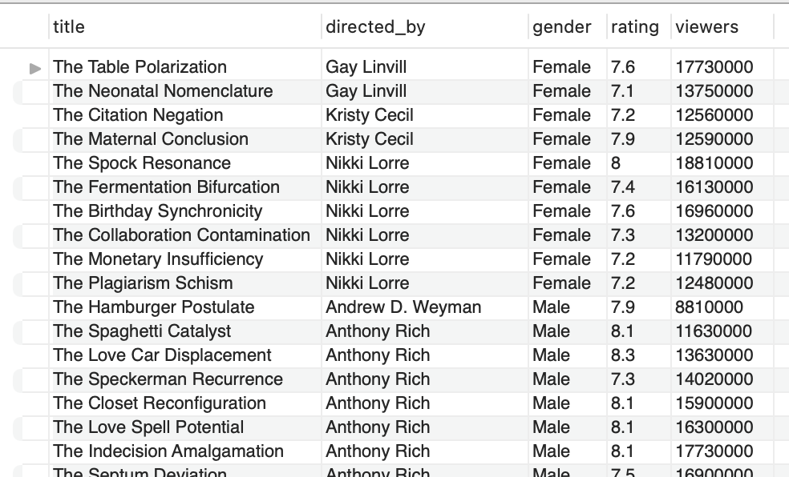
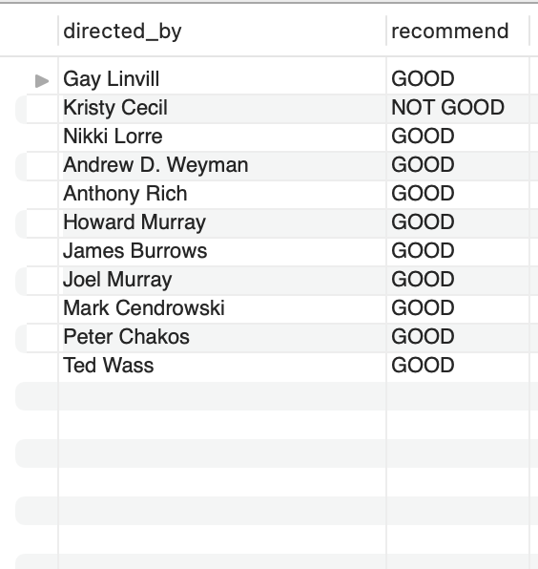
Views 2
Using the 1st view to create a 2nd view

Slide 11
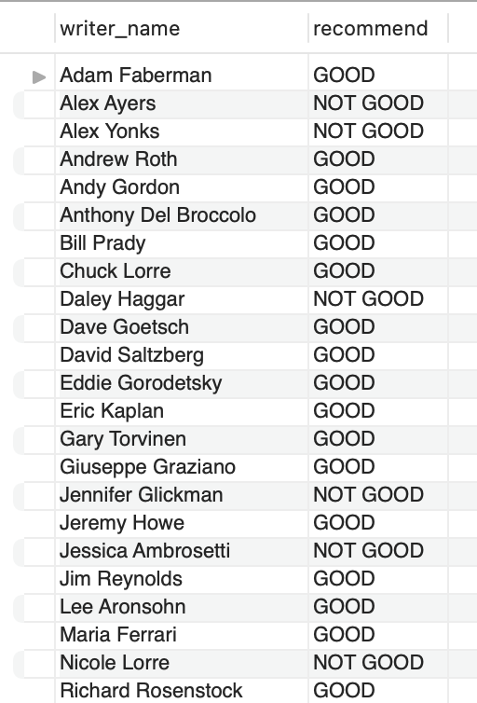
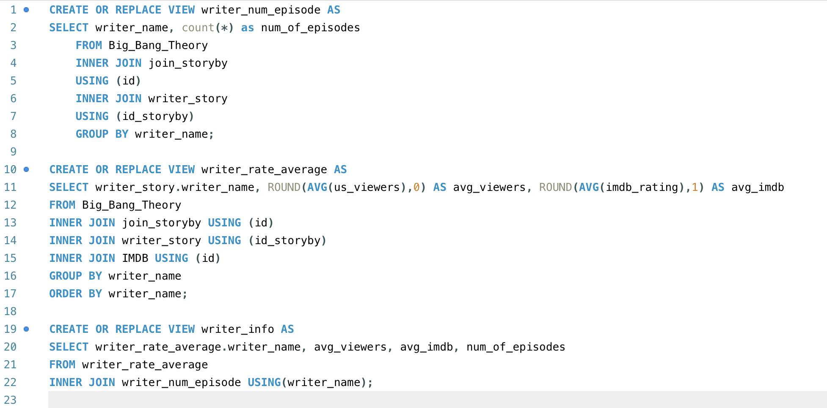
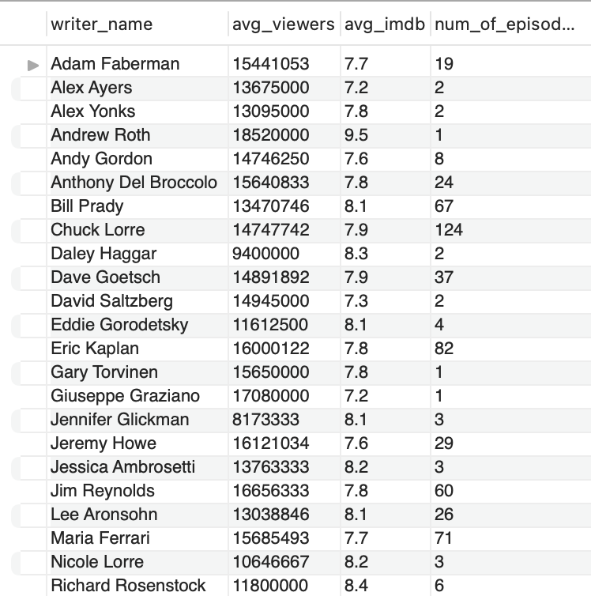
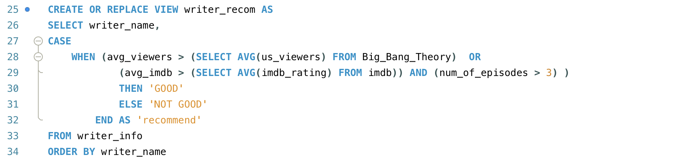
Views 3
Writer recommendation based on viewership & IMDB rating

Slide 12
THANK YOU

